Slide 1
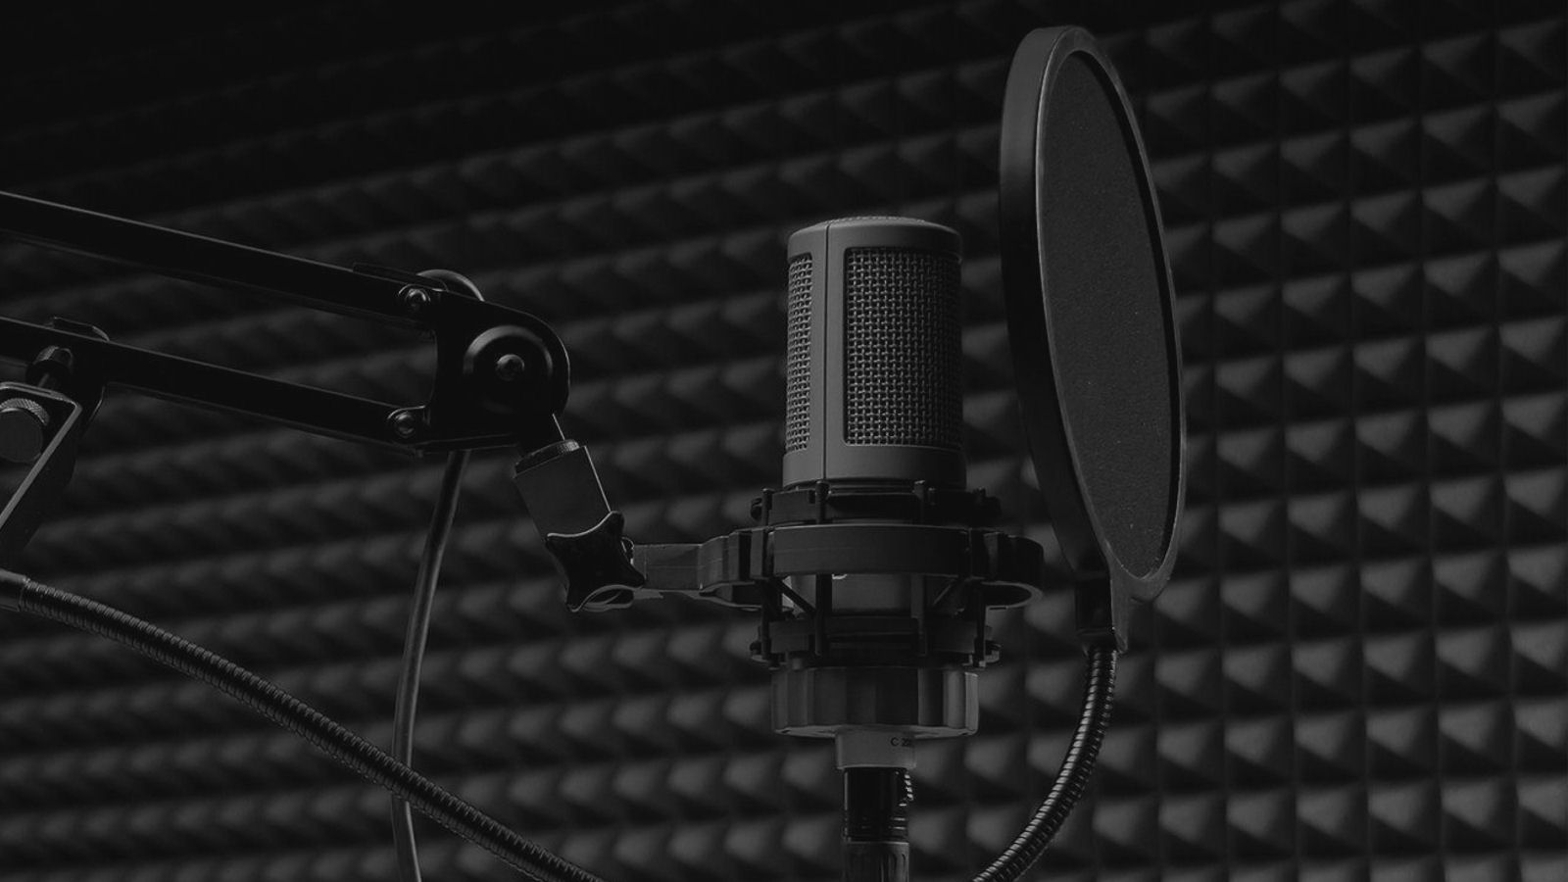
Audio Production
Basics of Audio Recording on a Budget

Slide 2
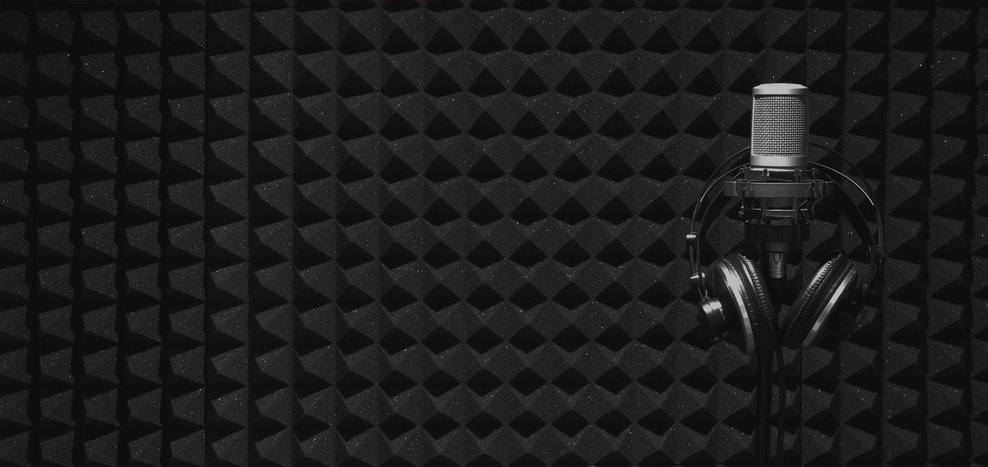
What Are Your Goals?
Podcasts or Large Scale/Multi-track Recording?
  May be determined by available space
  May be defined by student and/or staff interests
  May be defined by budget
No matter how your studio project begins, you will probably find that once staff and students get involved with the recording process your needs will grow. The beauty of recording in the current age of Digital Audio Workstation software is that setups are extremely flexible and expandable.

Slide 3
Don’t Worry About the “Buzz Words”
While there are extremely important basic concepts there are also a lot of different phrases and terminology that are good to know, (but not critical), to the process of setting up your basic studio environment. We will touch on a few of them in this presentation.
So let’s start with the basic concepts…

Slide 4
Those Extremely Important Concepts
Microphones: Different types
  Dynamic – moving coil type microphone. Reacts in direct response to sound pressure to make the coil move. Basically the opposite of a speaker.
  Condenser – electrically charged surfaces, (one typically a very lightweight diaphragm), respond to sound pressure changing the distance between them and this variance in capacitance, (along with a preamp and “Phantom Power” or a battery), helps to create a usable audio signal. Condenser mics tend to be much more sensitive.
  Ribbon – similar to condenser mics but usually much more expensive, (so we won’t go into those).

Slide 5
Those Extremely Important Concepts
Microphone pickup patterns
  Cardioid – most common. Pickup pattern is like a heart.
  Super-Cardioid – Tighter pickup in front of microphone. Good off-axis rejection with additional pickup behind the microphone at close proximity.
  Hyper-Cardioid – Even tighter pickup in front of microphone. Better off-axis rejection. More pickup behind microphone at greater distance.
  Bi-Directional – Sometimes called a ‘Figure 8’ pattern. Exactly what it sounds like. Equal pickup in front and behind mic with virtually full off-axis rejection.

Slide 6
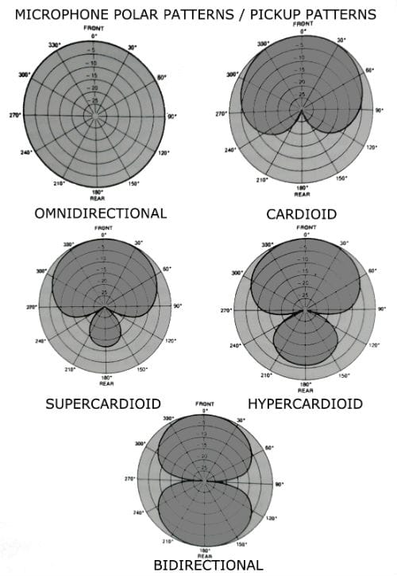
Those Extremely Important Concepts

Slide 7
Those Extremely Important Concepts
Microphones – what should I use?
  You probably already know the answer: “It depends”
    What are you using the mic for recording or live sound? (We’ll assume you are recording since you are here).
    What are you recording – vocal(s) or instruments? One person/instrument or more than one?
    Are you recording in stereo or a mono track?
    What is the environment? (Studio, auditorium, outside?)
    How much background noise is present?
    What is your budget?

Slide 8
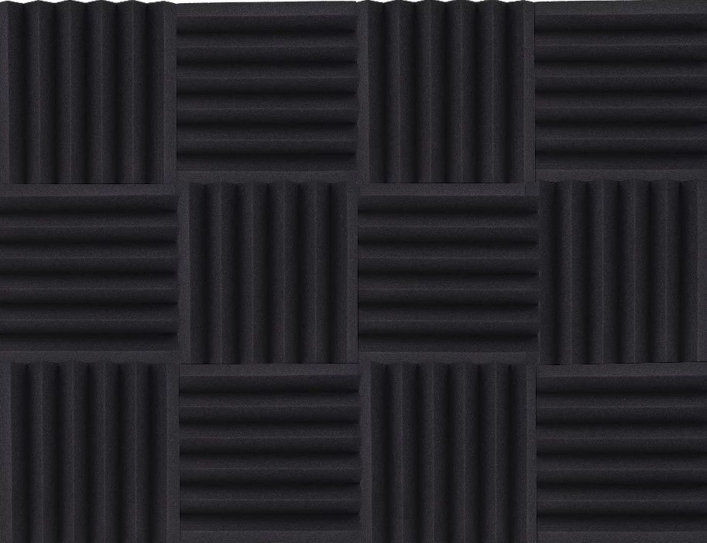
Microphones: “Industry Standards”
Most Common Types of Microphones:
  Small Diaphragm or ‘Pencil’ Mic – this style of microphone works best for instruments, capturing groups (three or four of these spread across a choir or band/orchestra work very well!), or as ‘overhead’ mics for a drum set.
  Large Diaphragm Condenser Mic – this will give you the broadest audio spectrum, (20Hz – 20KHz), while capturing every nuance of the speaker or singer. There are quite literally thousands of these microphones to choose from and your needs and budget will most likely determine what will work best for you and your situation.
  Dynamic Vocal Mic – while less sensitive than the previous microphone, a dynamic mic designed for singers is a good choice for recording a vocalist with a lot of power to their voice. Typically tuned more towards voice frequencies, (80Hz – 12KHz).

Slide 9
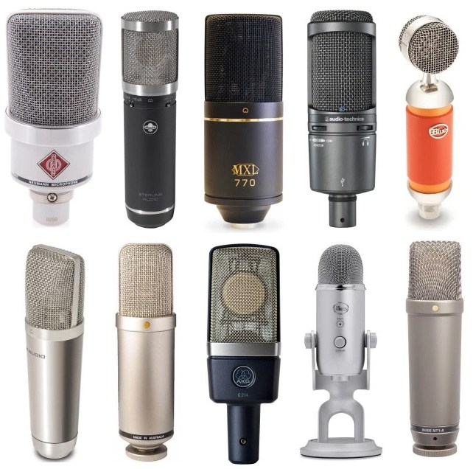
Microphones: “Industry Standards”
Large Diaphragm Condensers:
  There are a lot of them! Pictured here are just a few but mics consistently reviewed as industry standards are:
    Neumann U87 - $3600.00
    Neumann TLM 103 - $1319.95
    AKG C414 - $1099.00
    Audio-Technica AT4050 - $699.00
    Rhode NTK - $529.00
    Rhode NT1A - $359.00
    Blue Yeti Pro - $249.00
    Audio-Technica AT2050 - $229.00

Slide 10
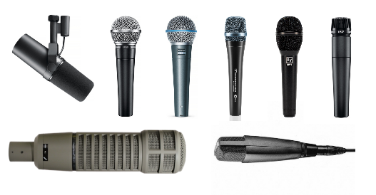
Microphones: “Industry Standards”
Dynamic Microphones:
  There are a gazzillion of these as well! Pictured here are a few of the most consistently reviewed mics as industry standards:
    Electro-Voice RE20 - $609.00
    Shure SM7B - $499.00
    Sennheiser MD 421-II - $479.95
    Sennheisser e935 - $179.95
    Shure Beta 58A - $159.00
    Electro-Voice ND76 - $146.00
    Shure SM58LC - $99.00
    Shure SM57LC - $99.00

Slide 11
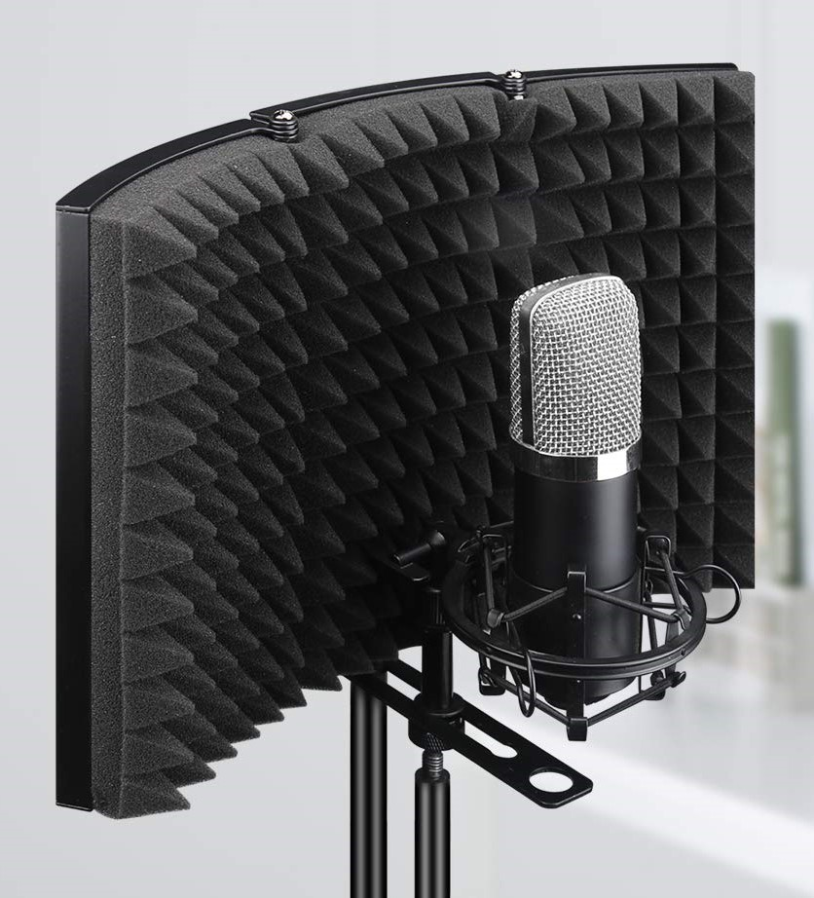
Microphones: “Best Practice”
Isolate Microphone from Noise:
  There are several options to help isolate a sensitive microphone from background\ambient noise. If you have the luxury of a dedicated room for your studio you can use a variety of acoustic panels and ‘bass traps’ to configure the room for good acoustics.
  For the rest of the world an acoustic isolation shield like the one pictured works extremely well and in almost any audio environment. They vary in size and price but typically between $40-$80.

Slide 12
Microphones: You Don’t Need Those!
Is it wonderful to have fantastic, high-end, name brand microphones? Of course it is!!! Are there other mics that will work just as well? 85% of the time – YES!!! They are significantly cheaper, too!
Number One Rule-of-Thumb for mic selection: Fit the mic to the job!
Number Two Rule-of-Thumb for mic selection: Budget is important!
Number Three Rule-of-Thumb for mic selection: It does you no good at all to have the best mic in the world and no way to utilize it!

Slide 13
Microphones: Don’t Break The Bank!
Great Podcast Mics that are inexpensive and USB, (there is a standard version for almost every mic listed here).
  Neewer NW7000 USB mic w/Suspension Arm, Shock Mount, and Pop-Filter. Even as a self-proclaimed “audio snob” – I love this mic! $37.99 on Amazon.
  CAD U37 USB mic w/Table Top tripod stand. If you want a ‘brand-name’, (ie: not Chinese built capsule), this is a great choice and built here in Ohio. $69.00
  Blue Yeti Nano USB mic w/Table Top stand/base. Duo-pattern, (cardioid and omnidirectional), with built-in volume control. $99.99
  Audio-Technica AT2020USB+ mic w/Table Top tripod stand. While not their ‘flagship’ microphone this mic offers the quality of the Audio-Technica brand at an affordable price. $149.00 (Package deal w/Suspension arm and Audio-Technica headphones - $199.00).

Slide 14
Microphones: Don’t Break The Bank!
If you want a mic you can use with a mixer there options for that too! You’ll need either a mixer or preamp with USB output.
  Behringer U-Phoria UM2 interface. One combination XLR/TRS plus one ¼” input w/headphone monitor and analog stereo RCA outputs. $39.99
  Focusrite Scarlett 2i2 two channel interface. Industry standard professional quality. Focusrite has made some of the most widely respected mic-pre’s for decades and can be found in most professional studios. $199.99
  Behringer XENYX Q802USB mixer w/USB output. Behringer offers several different variations of USB output mixers. This is their starting point w/two XLR/TRS mono channels plus two ¼” stereo channels, F/X loop, and separate monitor send. Best “bang-for-the-buck” out there. $119.99
  Mackie PROFX8V2 8-Channel Compact Mixer with USB and Effects. Mackie is one of the premiere makers of affordable audio mixers. This unit includes two XLR or ¼” mono channels, two XLR mono or ¼” stereo channels, plus one ¼” stereo channel. Built in effects and discreet monitor send. $219.99

Slide 15
Microphones: Don’t Break The Bank!
Affordable standard (XLR) large diaphragm connection microphones: (ALL of these mics will need either a USB interface or mixer to provide Phantom Power to the mic and convert the signal to digital format).
  Neewer NW700 mic w/Suspension Arm, Shock Mount, and Pop-Filter. Standard version of NW7000-USB mic. $26.99
  Samson C01. This mic is a durable cardioid pattern mic. Shock mount available separately. (You can typically find the mic w/mount for $79.99)
  AKG Perception P220. Cardioid pattern mic w/shock mount included. LF roll-off switch and -20db pad switch built-in to mic. $149.00
  Audio-Technica AT2035 Podcasting Pack. Package deal w/suspension arm, shock mount and Audio-Technica headphones - $199.00
  They just go up in price from here…

Slide 16
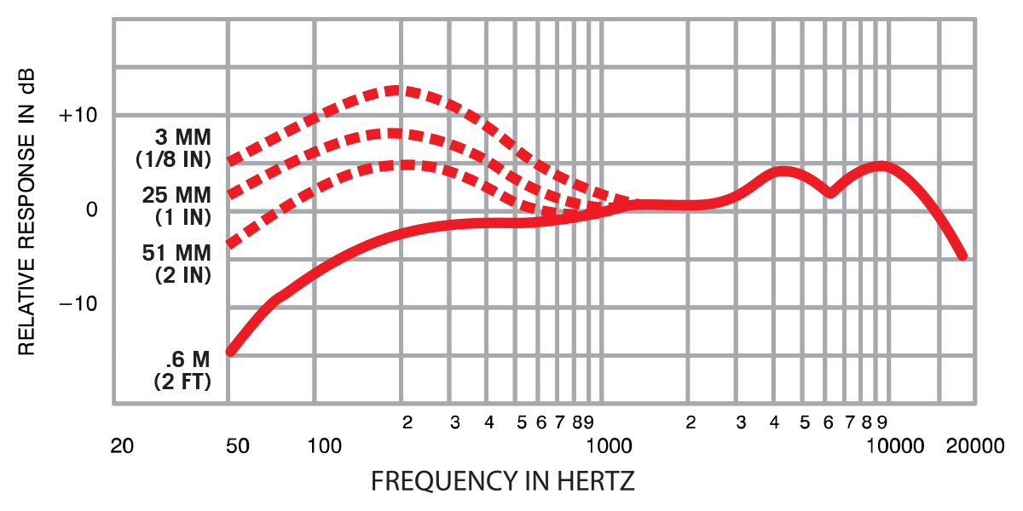
Microphones: How to Use Them
Miking techniques
  Proximity Effect – your best friend and your worst enemy!
    Proximity Effect is (basically) the frequency response range based on the closeness, (proximity), the sound source is to the microphone.

Slide 17
Microphones: How to Use Them
Proximity Effect
  Your Best Friend: in order to get a more full spectrum sound the sound source needs to be close to the mic thus allowing you to reduce the gain and help eliminate background noise.
  Your Worst Enemy: if you have a person talking that is afraid of the mic and/or you are using one or two mics to try to record a group you’re in deep doo-doo!
This is why microphone choice is so drastically important, (and why I’m devoting so much time to it).

Slide 18
Microphones: How to Use Them
Basically: in almost all cases you want the microphone as close as possible to the sound source.
Obviously – this is not always possible. Condenser mics are your friends in those cases, (ie: recording someone with video and you want the mic out of the picture, recording multiple sound sources with limited microphones, etc.).
  For video: use a lapel or lavalier mic, or a ‘shotgun’ mic.
  For multiple sources: distance and number of people, (could be instruments or whatever you are trying to record), will determine mic placement and selection, (this gets a little too deep for this session but I will be happy to answer questions later or by email).

Slide 19
Recording Software
While there are multiple options for this component of a recording studio we will focus on keeping costs down and therefore focus on freeware/shareware/donationware or ‘freebies’ with a purchase.
Audacity – free multi-track recording software with available plug-ins and file converters. Seriously – this will do just about everything most Digital Audio Workstations, (DAW – one of those buzzwords), will do except for sequencing and/or MIDI playback.
Voicemeeter Banana: Fantastic for podcasting! So far the only software I’ve found that will let you use two USB mics and give you independent control of each one. Allows for multiple routing/bussing and effects, (including channel ducking).

Slide 20
Recording Software (continued)
Presonus StudioOne OEM: OK – this is not free/share/donate-ware either… however – it does come free with a few different USB/MIDI keyboard controllers. The OEM version allows for three installs off of the same license key. This is the software that I currently use as my DAW. You can purchase it and unlock VST, (Virtual Studio Technology – basically an accepted industry standard protocol for effects and processing tools), plugins. The ‘freebie’ is fully functional and has no time limit like trialware. There are several of these out there that come packaged with different keyboard controllers as ‘perks’ for buying from whichever company has the software you personally like, Ableton-Lite Live, (Teacher/Student educational version available).
Pro Tools | First: free version of the industry standard for audio production. Functional for up to 16 tracks.

Slide 21
Recording Software (continued)
  Tracktion: Free fully functional DAW including VST plugins and sequencing/looping. No limits on tracks or time. (Personally I find this software a bit “un-intuitive” but honestly – that is just me and what I’m used to).
  Soundtrap for Education: Cloud based collaborative DAW software that is cross platform/device, (PC/laptop, Chromebook, iPad, Tablet, Smartphone). Exactly what it says on the label – very powerful and extremely flexible, this software package will let you work as an individual or a group on anything from basic podcasting to full music production and recording. This is not free/share/donation-ware. They have specific pricing. I mention it mostly because of its extreme flexibility.
There are a bunch more out there – most are not free… the majority are trial or limited functionality/time versions. If there is something your district likes/uses – by all means continue to do so. I am not endorsing nor promoting any specific platform for software or hardware what-so-ever. I am only trying to give you options.

Slide 22
Monitors: Headphones
This is kind of simple. You want full range, (20Hz-20KHz), flat response, and closed back, (no sound bleeds out), headphones. Lots of options – sadly… the good ones aren’t cheap!
Recommended Brands: AKG, Audio-Technica M-Series, Fostex RP series, Tascam, Sony.
If you are doing podcasting you don’t really need as high quality headphones. The podcasters just need to hear each other, (if they are interviewing someone), and/or themselves.

Slide 23
Monitors: Speakers
Honestly this is tougher than headphones. Room acoustics and speaker placement with relationship to the room/acoustics has a great deal of influence on your choice. However there are ways to minimize the affect of those variables. One thing that you’ll want to look for regardless of the room will be at least bi-amped active, (powered), monitors. Simply put – this just means separate but balanced built-in amplifiers for ‘woofers’, (lower midrange frequencies and below), crossed-over between ‘tweeters’, (upper midrange and above).

Slide 24
Monitors: Speakers (continued)
Try to find monitor speakers with a front facing port. This will help to minimize the effect that the distance from a wall will have on your speaker. Rear facing ports are much more common and tend to enhance the lower end frequencies the closer they are to a reflective surface, (ie: a wall or even worse a window). Ideally you don’t want the room to ‘color’ the sound of your monitors in any way. The goal is to achieve a ‘flat’ response from the monitors so that the program can be accurately mixed.

Slide 25
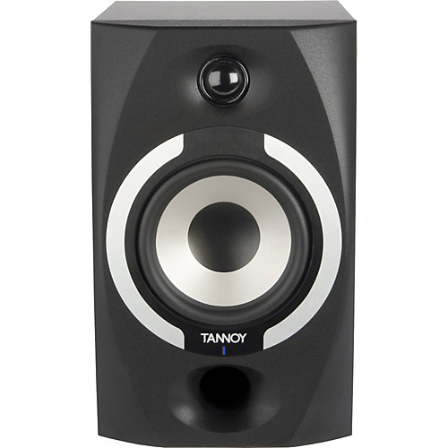
Monitors: Speakers (continued)

Slide 26
Monitors: Speakers (continued)
Examples of front port monitors:
  KRK V-Series 4
  Presonus Eris E5 or E8
  Sampson Resolv Series
  Tannoy Reveal Series
  Edifier R1700BT – while not technically studio monitors, I personally love these little guys! They are very accurate with upper-end frequencies and very affordable, (as well as Bluetooth capable). Edifier offers a wide range of affordable monitors my only problem is no one stocks them so you can only get them online. Being an audio ‘snob’ I actually like to hear anything before I buy it.

Slide 27
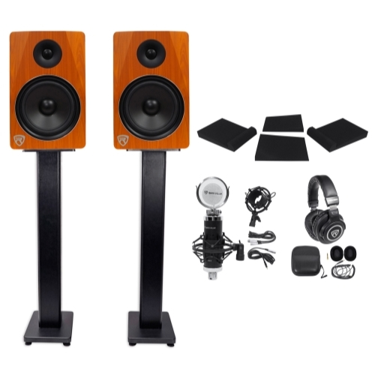
Monitors: Speakers (continued)
If you are looking for a really good value with very good quality components – basically a ‘studio-in-a-box’… I can personally recommend this package, (you will need an interface):
Rockville Studio Package:
(1) Rockville APM8C 8" 2-Way 500W Active/Powered USB Studio Monitor Speakers Pair
(1) 2) Rockville RHTSB 36" Inch Surround Sound Home Theater Speaker Stands
(1) Rockville PRO-M50 Studio Headphones w/ Detachable Coil Cable, Case, +Extra Ear Pads
(1) Rockville RCM03 Pro Studio Recording Condenser Microphone Mic w/Shock Mount
(1) Pair Rockville RRS263M Foam Studio Monitor Isolation Pads 10.35" x 13"/3 Angles

Slide 28
Mixers: Just In Case
I briefly mentioned mixers earlier but unless you are recording sessions where you need to use multiple microphones/inputs simultaneously, you probably won’t need to use a mixer.
If you do need a mixer the ones I mentioned earlier are good choices depending on how many inputs you need.
One instance you may need a mixer is your GreenScreen setup. If you have more than one person and are using clip-on lavalier mics a mixer will basically be a necessity. Check your camera to see what inputs, (if any), it supports.

Slide 29
Putting It All Together
So now you have a bunch of stuff. A couple of microphones, headphones, powered speakers, software for recording and/or sequencing, and a pile of various cables. How does it all go together and what’s the best way to set it up?

Slide 30
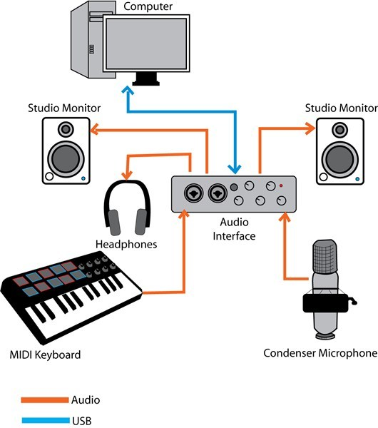
Putting It All Together

Slide 31
Putting It All Together - Hardware
Cables
  Honestly don’t skimp on the cables. Get good quality cables with solid metal ends and strain relief where possible, (try not to use cheap cables with molded ends).
  Where the option exists use balanced/low-impedance cables, (XLR or ¼” Tip-Ring-Sleeve [TRS]). These cables/ connections will provide the best signal-to-noise ratio as well as RF rejection with the added bonus of allowing for longer cable lengths without signal loss*. If your only option is RCA connections then just make sure you use good quality cables for maximum RF rejection.
  * NEVER run a unbalanced or hi-impedance cable longer than 25’

Slide 32
Putting It All Together - Hardware
At the center of everything is your audio interface. Now – if you are just doing podcasting, (or any single source recording via USB), you won’t necessarily need an interface. Your computer will perform that task and your setup will be much more simple. For everyone else that interface is crucial to your entire studio working the way it should. Every audio input goes into it and every audio output flows from it. (If you try to plug your headphones into your computer to monitor everything instead of using the interface you will hear a whole lot of nothing!)

Slide 33
Putting It All Together - Concepts
Gain Structure:
  This is one of those really important concepts and it can definitely make or break the quality of your recordings and/or final product. It’s also sadly often ignored when people are setting up any audio system whether it is live sound reinforcement or recording.
  The basic premise is: create the maximum signal-to-noise ratio from your source to your input channel without distortion. That means your source needs to be loud enough that you don’t hear a lot of ‘hiss’ in the background but not so loud as to create a ‘fuzzy’ sound. The easiest way to do this is to set the level on your channel to 0db and then increase the level from your source until the monitor meter show the actual signal ‘hitting’ that level without going over.

Slide 34
Putting It All Together - Concepts
Gain Structure:
  This same concept applies to your monitoring devices as well whether they are headphones or speakers you want the audio program loud enough that it is easy to hear clearly with out distortion. I honestly cannot stress the importance of this concept because it is the basis for a good sounding recording, (or live performance).
Miking Techniques:
  As stated earlier in almost every case you want to get the mic as close to the source as possible. There are exceptions which include miking groups or video situations where a visible microphone is undesirable. Also when miking an acoustic guitar or piano you will want to capture some of the room ambience. Be careful though because you can create a situation where you have Phase Cancellation.

Slide 35
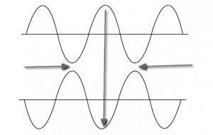
Putting It All Together - Concepts
Phase Cancellation:
  Sound moves in waves with amplitude, frequency, etc. Phase cancellation occurs when the amplitude of a source being miked with multiple mics becomes portrayed out-of-phase by them.

Slide 36
Putting It All Together - Concepts
Phase Cancellation (cont.):
  Thankfully it can generally be corrected by changing the placement of the microphones. However sometimes you can’t really change the mic placement or you already recorded the source and didn’t realize that cancellation was taking place. Most DAWs offer a ‘180° Phase Inversion’ which should fix the problem.
EQ
  There is a reason I have moved this back for discussion. Frequency Equalization, (or EQ), can be a wonderful and very dangerous thing at the same time. If you do every-thing correctly and have decent mics you shouldn’t have to ‘tweak’ the EQ much. This is especially true for voice recording. Spoken word recordings should sound as natural as possible. You don’t want to color the voice.

Slide 37
Putting It All Together - Concepts
Compression:
  Compression is simply ‘squishing’ the dynamic range of a source down to a more consistent level. Again this is a wonderful yet very dangerous tool as well. Compression has four main characteristics:
    Threshold: The signal level at which the compressor ‘kicks in’
    Knee: The ‘strength’ of compression. Typically ‘Hard’ or ‘Soft’
    Ratio: How much compression is being used.
    Attack and Release: How fast the compressor kicks in and lets go.
  You never want to hear the compressor ‘breathe’. By this I simply mean you don’t want to hear a noticeable effect on the source. When done right you will never actually hear a compressor at all.

Slide 38
Putting It All Together – Plug-Ins
What are Plug-Ins:
  Plug-ins are anything you can add to an already recorded channel. They include, (but not limited to):
    Compression/Limiting, Noise Gates, EQ, Delay, Reverb, Pitch Correction (also known as ‘Auto-Tune’), Spatializing, Normalizing, Time Compression/Stretching, Synchronization/Quantizing, Physical Modeling, etc.
  VST Plug-Ins:
    I briefly mentioned these earlier. Virtual Studio Technology, (VST), plug-ins work regardless of the DAW software you use. The beauty of these is that you can use them on different platforms as well as different software. There are hundreds available for free and many, many more available to purchase. As I also mentioned earlier some DAWs limit whether you can use these or not, (ie: PreSonus Studio One: OEM).

Slide 39
Putting It All Together - Execution
Recording:
  DO A TEST TRACK! Even for just 10-15 seconds. Have your source give you the loudest they intend to be as well as there quietest. You want to make sure you have a good signal and that ambient/background noise is at a minimum. This also gives you the opportunity to set your levels based upon the ranges they give you.
  Don’t be afraid to tell a vocalist to get closer/farther away from the mic! Take control of the session!
  The beauty of the digital world is that you have no limits on number of ‘takes’ and/or tracks, (unless your software limits you), so if someone wants a ‘do-over’ don’t delete their previous track(s). You may find that you will be taking parts of one take and combining them with parts of other takes to create your final product.

Slide 40
Putting It All Together – Mixing/Editing
If you aren’t used to this it will take you a while to master it. You want a quiet room with no distractions. Listen through multiple monitors, (speakers and head-phones – preferably a couple of options for each).
Obviously a single voice will be easier to edit than multiple tracks of music. That being said – pay close attention to details. If you have a single voice speaking and they breathe heavy – edit out the breathing. Make your final product as clean and clear as possible.
Take breaks and get others to listen. We sometimes can get so focused on what we’ve heard over and over that we lose the big picture.

Slide 41
Putting It All Together – Mixing/Editing
SAVE YOUR PROJECT! This may sound obvious but it’s extremely important. If you need to go back and edit something you need that original project to do it.
Export your final mix to a user friendly format, ie: MP3, WAV, etc. It’s no good to people if they don’t have a way to listen to it!
Have fun and enjoy yourself! Encourage your staff and students to use the studio as much as possible. As with all of the Makerspace gear, this is a different world and people will probably need a ‘nudge’ to get going. Be ready to nudge, (or shove!), if necessary!

Slide 42
That’s It! Thank You for Attending!
Please don’t hesitate to contact me via email: mohm@scsmustangs.org if you have questions or want advice/opinions.

